Slide 1

External Review
Batch No: D2
Project Title : Online Hospital Management System with Machine Learning Approaches
S.No | Regd.No | Student Name
1 | 19A81A5K8 | Kankipati Sujitha
2 | 19A81A5O3 | Shaik Sai Baji
3 | 20A85A0525 | Vallabhaneni Naga Prudhvi
4 | 19A81A5K6 | Juttiga Mohan Raj Kumar
Project Guide:
A.Leelavathi -Sr. Asst. Prof.

Slide 2
Contents
Abstract
Literature Survey
Objective & Scope of the Project
System Architecture
Methodology and Design
UML Diagrams
Implementation
Result Analysis
Attainment of Objective
Future Scope of Project

Slide 3
ABSTRACT
The use of technology in Medicine and Healthcare has grown to a greater extent particularly during the pandemic period. The circulation of people in public is reduced considerably and people wish to do all possible work through online websites and mobile applications. Websites are the most popular and convenient means by which people can contact hospitals and other healthcare divisions. All the healthcare sectors require large database management systems to handle huge amounts of data regarding patients, doctors, consultants and treatments. To solve this problem, a database management system is developed for the hospitals to maintain all the data efficiently that can be accessed by patients, doctors and administrators via a common website. This system facilitates the patients to consult the doctors online and to provide online prescriptions via a chat box which facilitates both the patient and doctor to communicate. And 2this website facilitates the patients to check their health condition based on the symptoms.

Slide 4
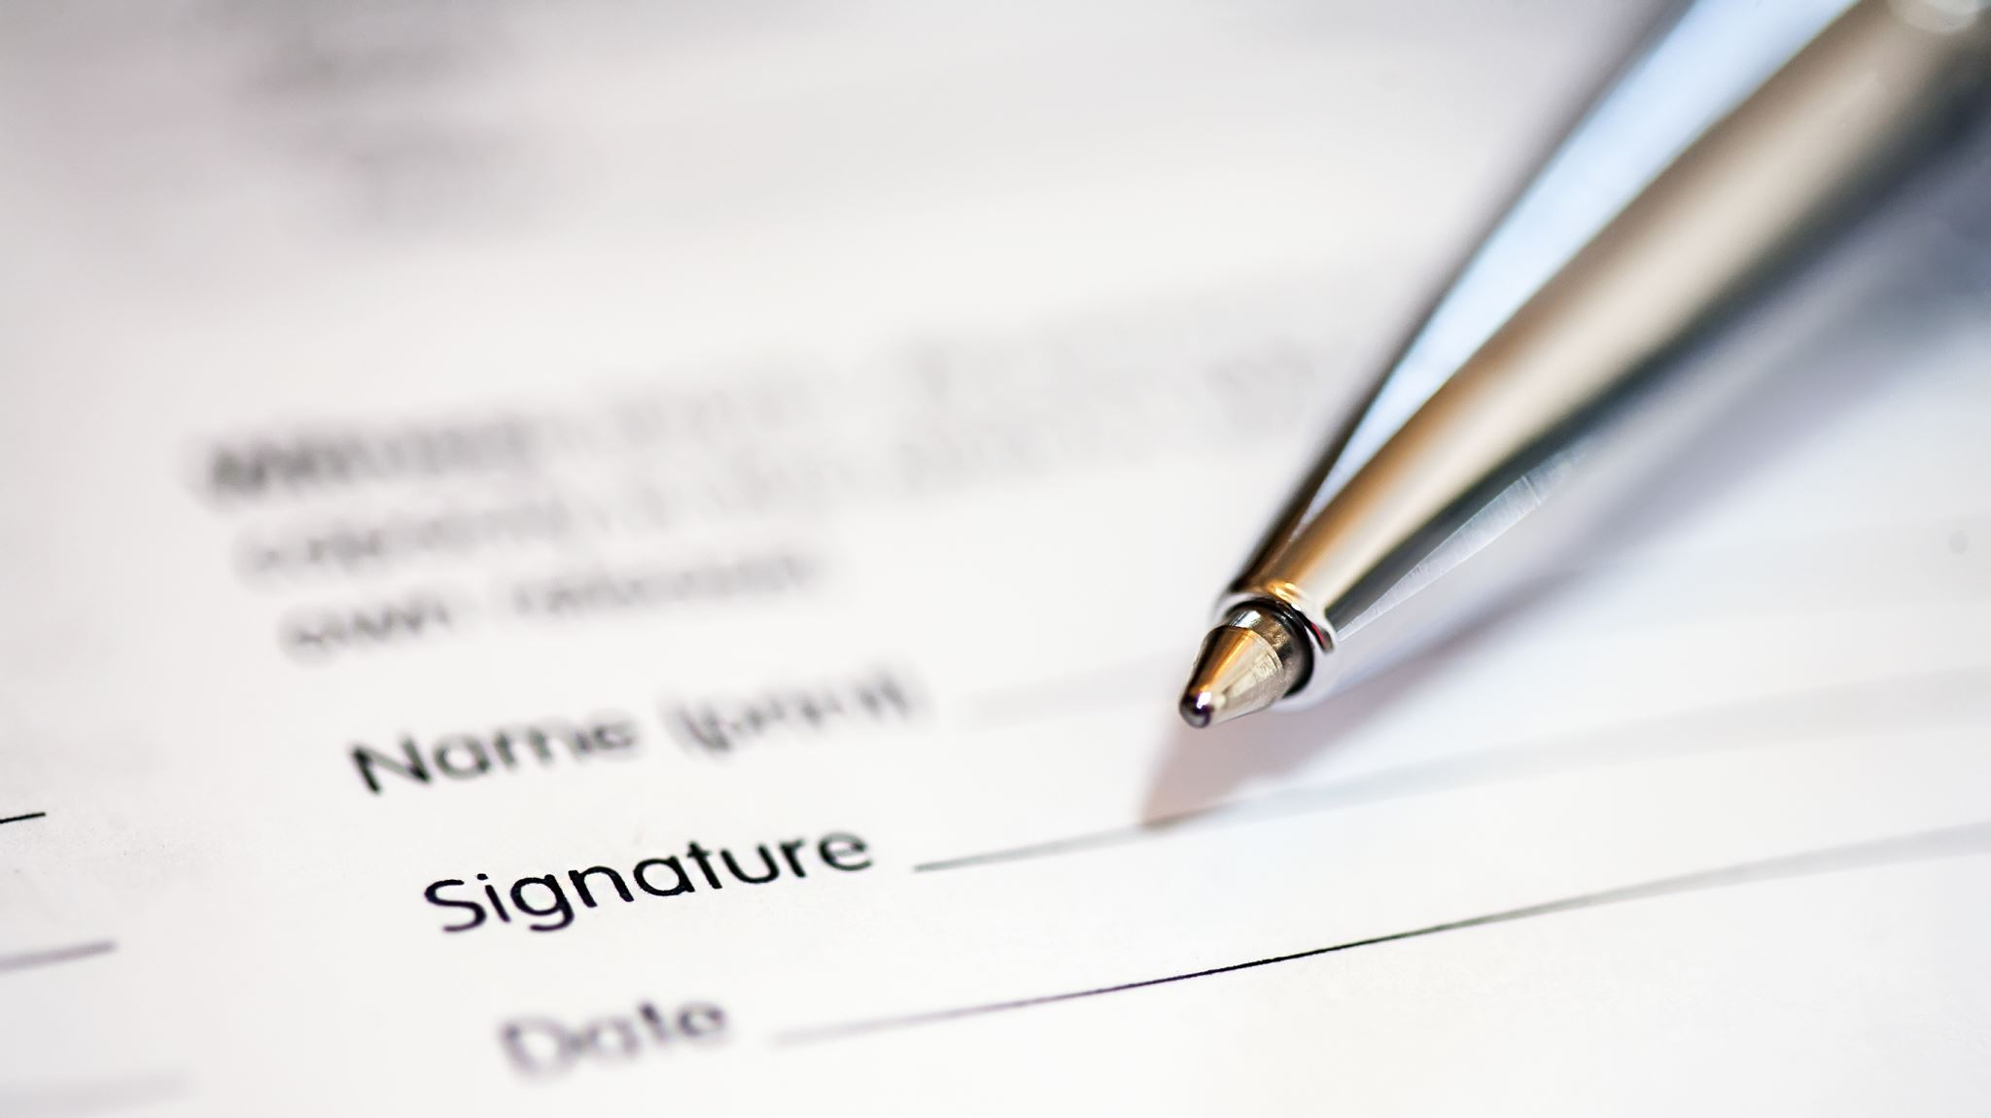
Literature Survey
978-0-7381-1327-2/21/$31.00 ©2021 IEEE
https://jpinfotech.org/online-hospital-management-system/
https://studentprojectguide.com/php/online-hospital-management-system/
https://phpgurukul.com/hospital-management-system-in-php/

Slide 5
Project objectives:
Doctor and patient can manage their accounts respectively.
Online(contactless) Medication for primary diseases.
Patients are not required for wait for long time.
The system predicts the disease based on the given symptoms.
The system suggests the doctors for predicted diseases.
The system allows the doctors and patients to communicate via chat box.

Slide 6
Project Scope:
This project has 3 users such as doctor, patient and admin.
Each User of the system are authenticated and provides role-based access.
The system allows the patient to give symptoms and according to those symptoms the system will predict a disease.
The system suggests doctors for predicted diseases and allows online consultation for patients.
The system helps patients to consult doctors at their convenience by sitting at home

Slide 7
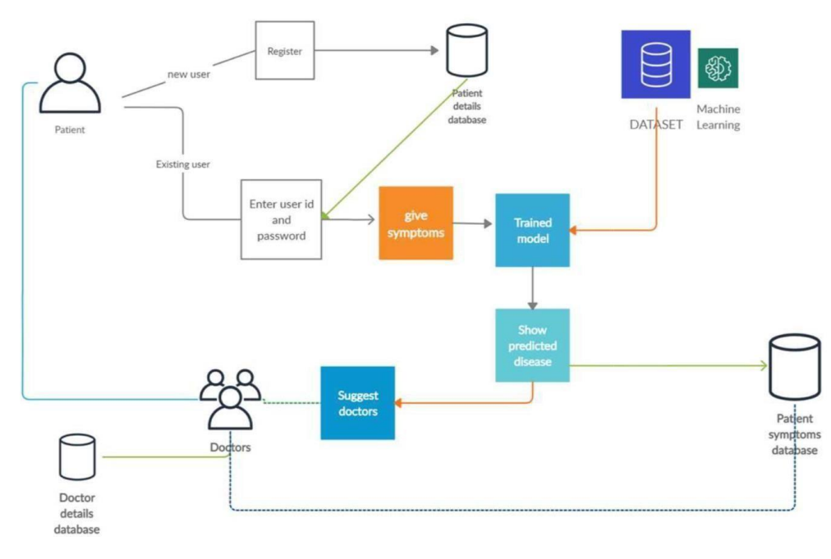
System Architecture:

Slide 8
Methodology and Design:
Machine Learning:
Machine Learning is the field of study that gives computers the capability to learn without being explicitly programmed. ML is one of the most exciting technologies that one would have ever come across. As it is evident from the name, it gives the computer that makes it more like humans: The ability to learn. Machine learning is actively being used today, perhaps in many more places than one would expect. Machine learning is data driven technology. Large amount of data generated by organizations on daily basis
Naïve Bayes:
Naive Bayes classifiers are a collection of classification algorithms based on Bayes’ Theorem. It is not a single algorithm but a family of algorithms where all of them share a common principle, i.e., every pair of features being classified is independent of each other. Naïve Bayes algorithm is a supervised learning algorithm, which is based on Bayes theorem and used for solving classification problems. It is mainly used in text classification that includes a high-dimensional training dataset.

Slide 9
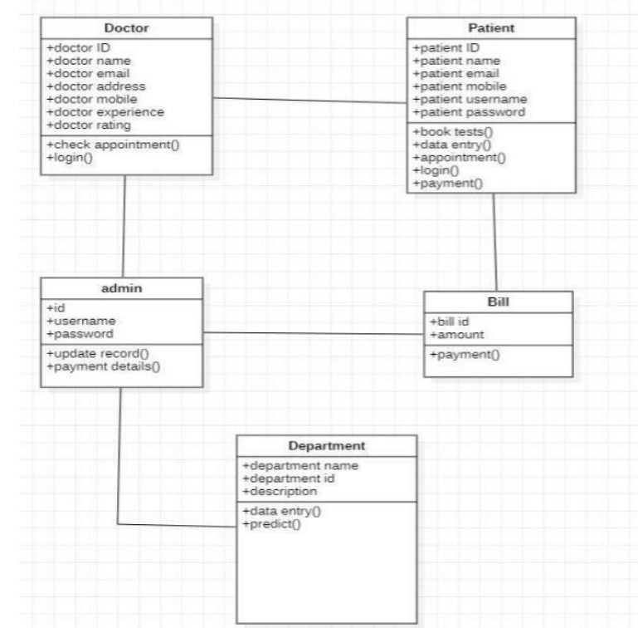
UML Diagrams:
Class Diagram :
A class diagram is a description of set of objects.
It represents the static view of an application.
Class diagram describes the attributes and
operations of a class and also the constraints
imposed on the system. Class diagrams are the
only diagrams which can be directly mapped with
object-oriented languages.

Slide 10
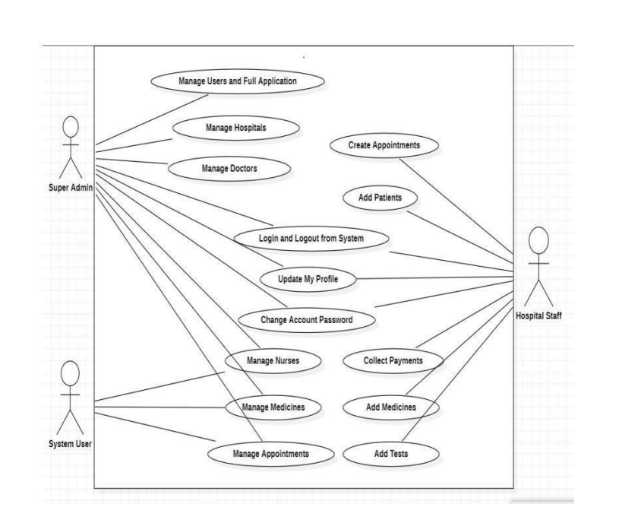
Usecase Diagram: A usecase diagram shows a set of usecases, actors and their relationships. An actor represents a set of activities that usecases perform while interacting. The purpose of usecase diagram is to capture the dynamic aspect of system.

Slide 11
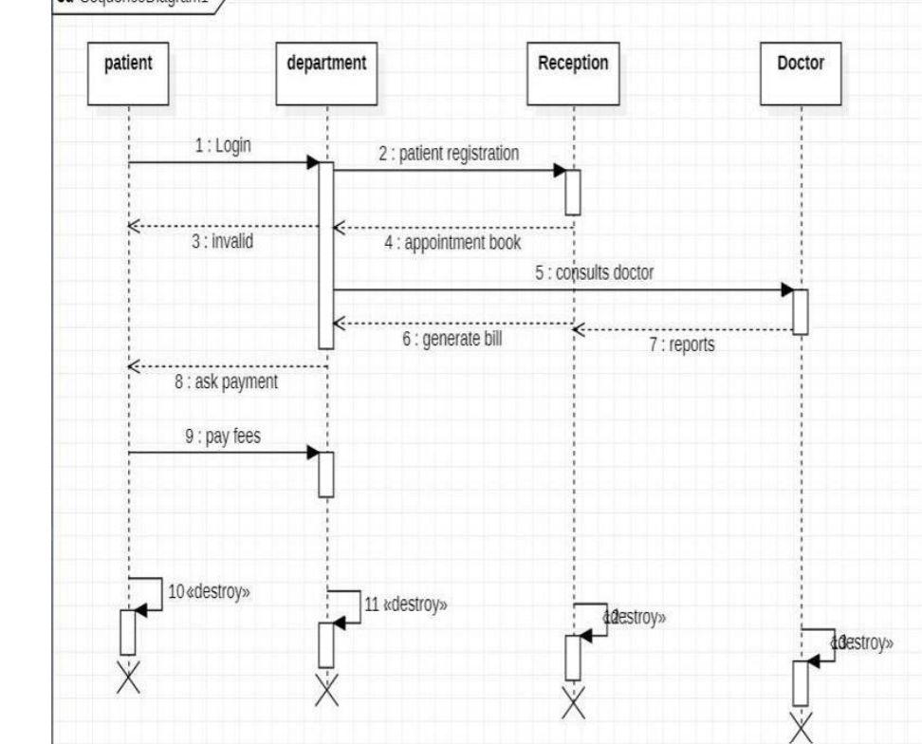
Sequence Diagram:
A sequence diagram emphasizes the
time ordering of messages. It is a
kind of Interaction diagram.
Graphically, it can be defined as
a table in which X-axis represents
the objects and Y-axis represents
the time ordering of messages.

Slide 12
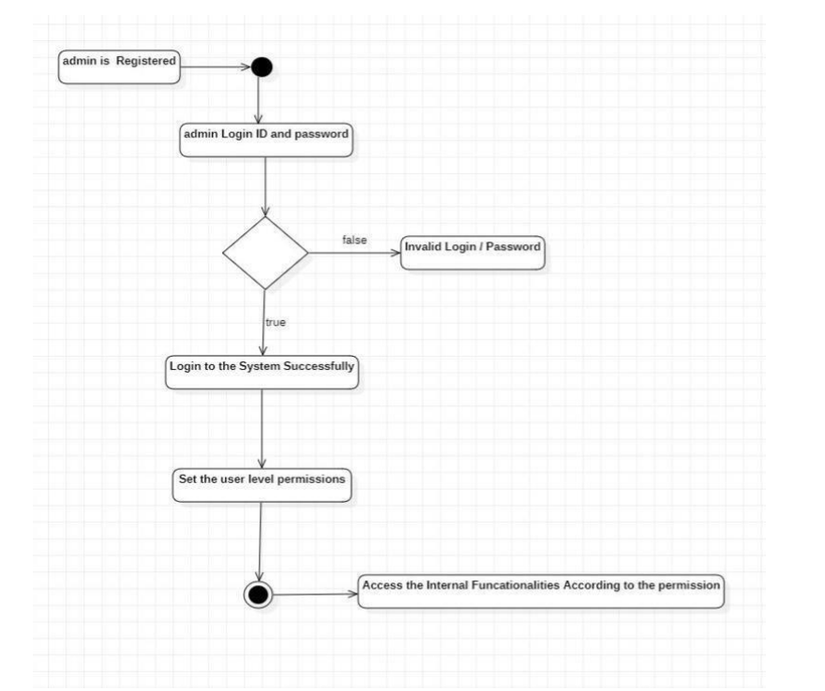
Activity Diagram:
An activity diagram is flowchart
to represent the flow from one
activity to another activity. The
control flow is drawn from one
operation to another. This flow
can be sequential, branched,
or concurrent. It deals with all
type of flow control by using
different elements such as
fork, join etc.

Slide 13
Implementation:
We implemented this project through visual code studio by using HTML, CSS, JS, Bootstrap
and jQuery as frontend languages and Django as backend. And we made use of PostgreSQL. In
this project we used Naïve Bayes algorithm to predict the disease based on symptoms. As this
project can be used by doctors, patients and admin, the data regarding this is stored in database
PostgreSQL database. After creating all the necessary files, create a virtual environment to run
The project with command “py -m venv env” then activate the created virtual environment with
command “env\Scripts\activate”. After this install Django and install all the software and the
packages. Now inorder to avoid the errors just make the migrations with the command “python
manage.py makemigrations” and “python manage.py migrate”. Now the project is all set and run
the project with command “python manage.py runserver”. After running the command, go to web
browser and type as “http://127.0.0.1:8000/” which displays the homepage of Online Hospital
Management System.

Slide 14
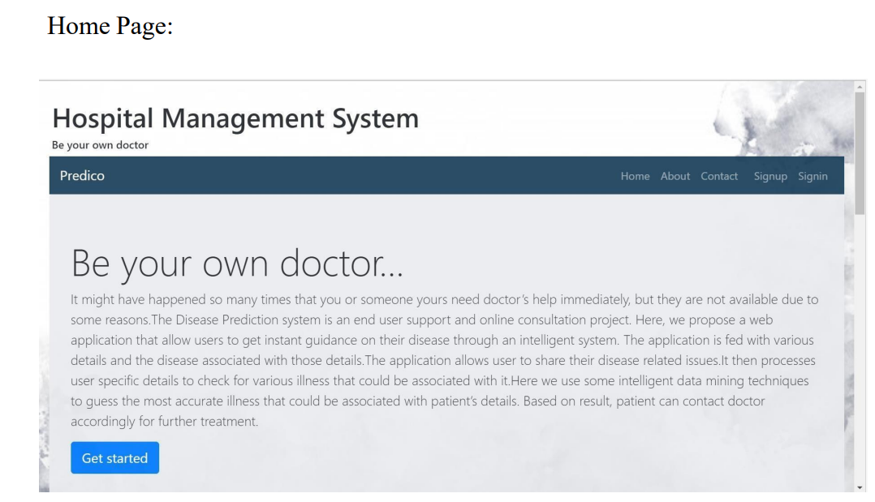
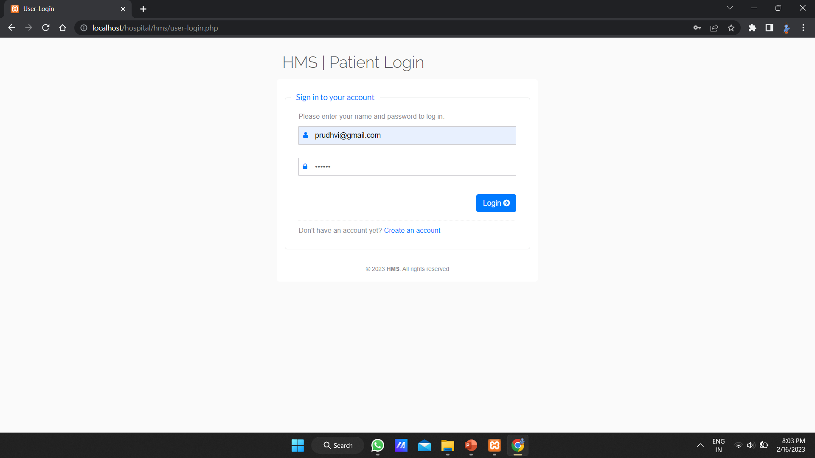
Result Analysis

Slide 15
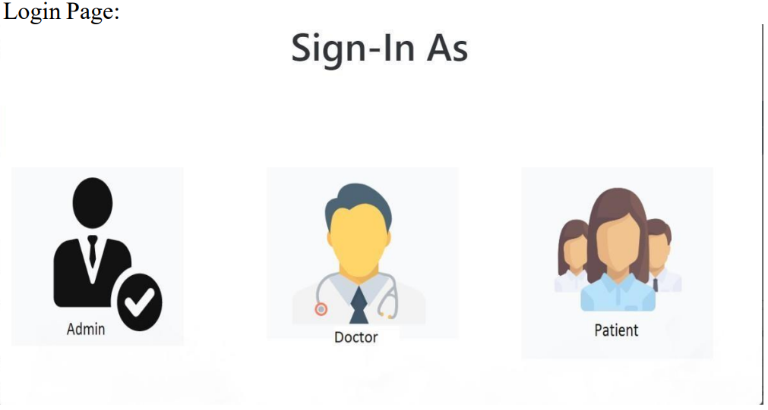

Slide 16
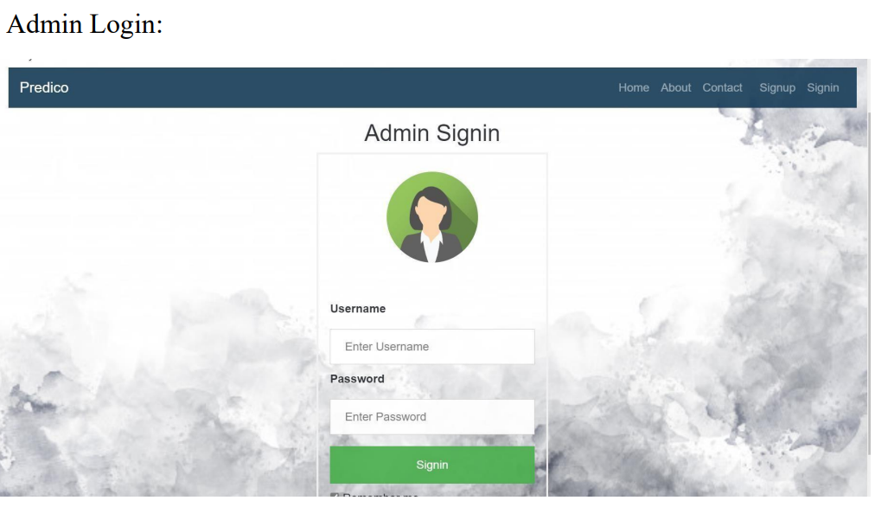

Slide 17
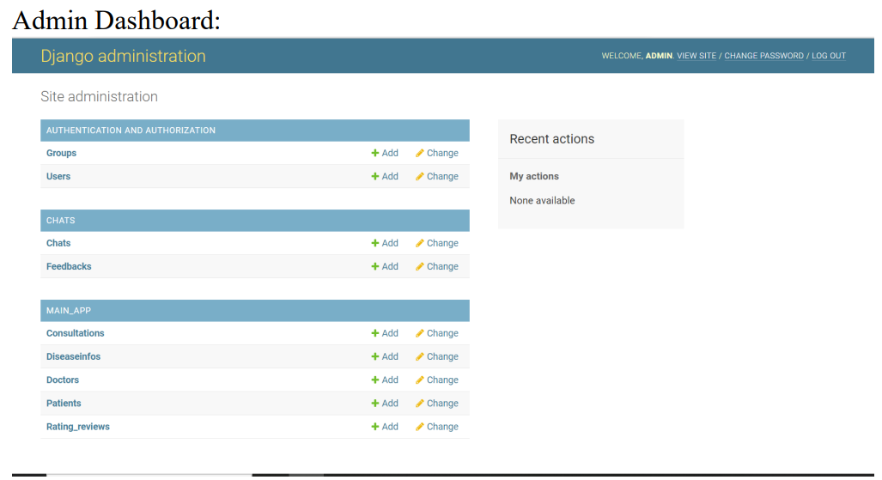

Slide 18
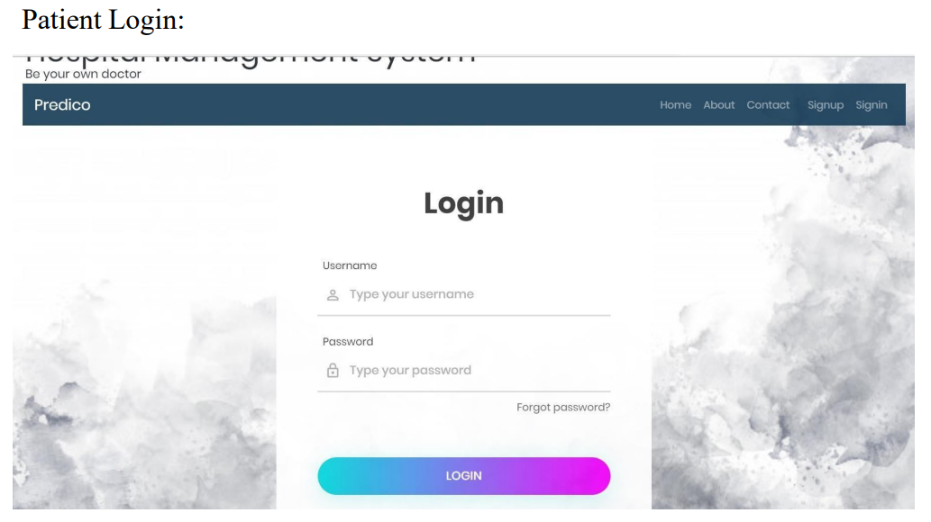

Slide 19
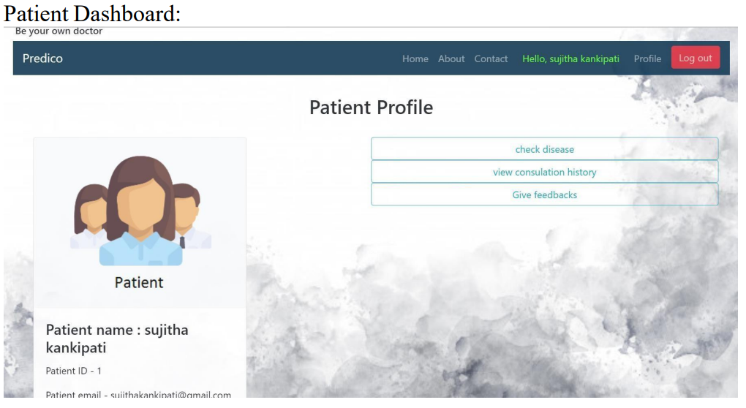

Slide 20
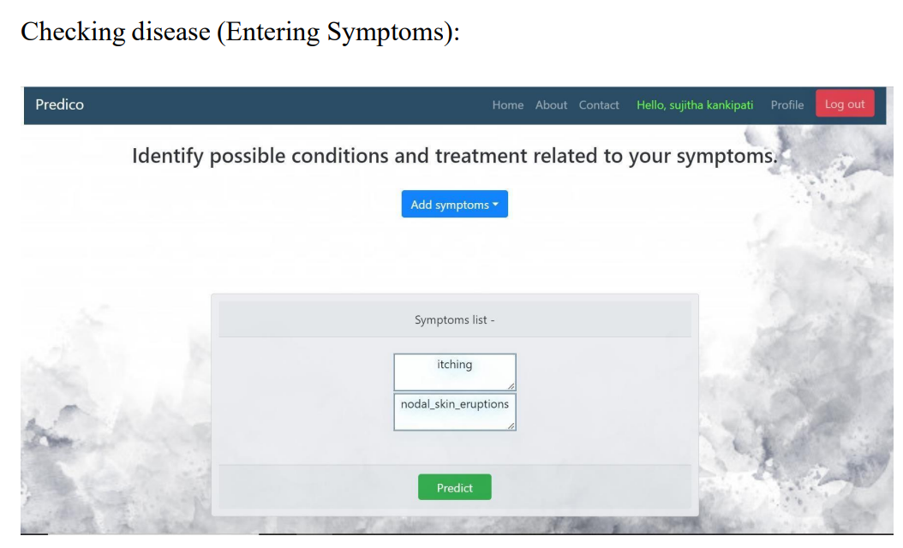

Slide 21
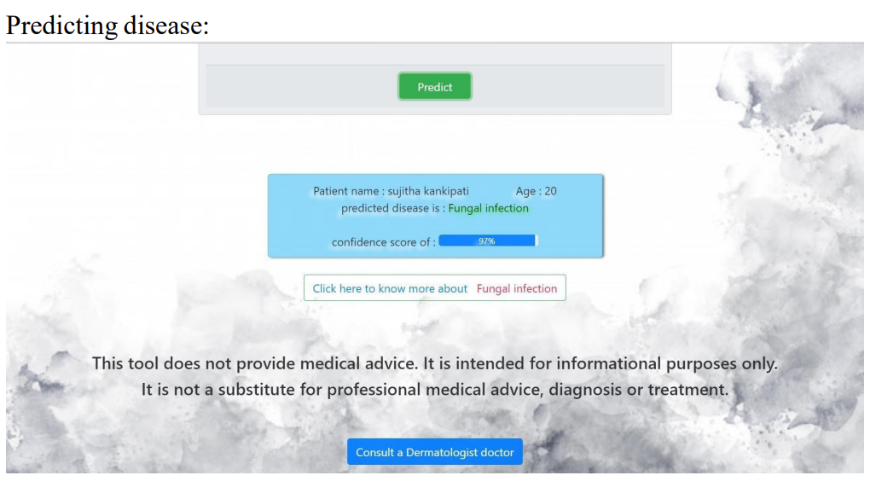

Slide 22
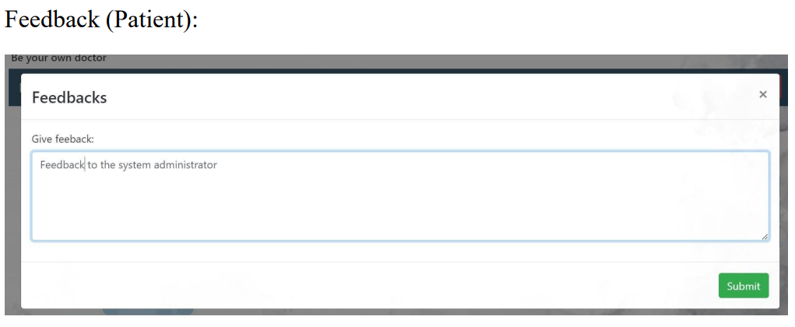

Slide 23
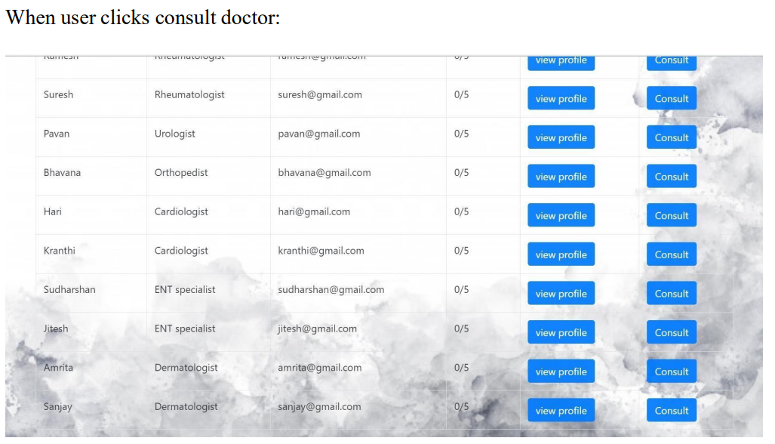

Slide 24
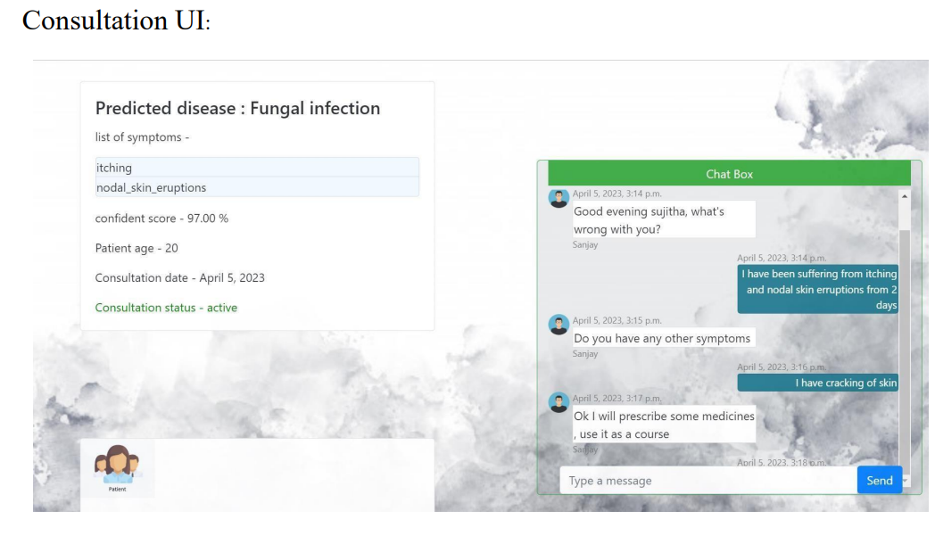

Slide 25
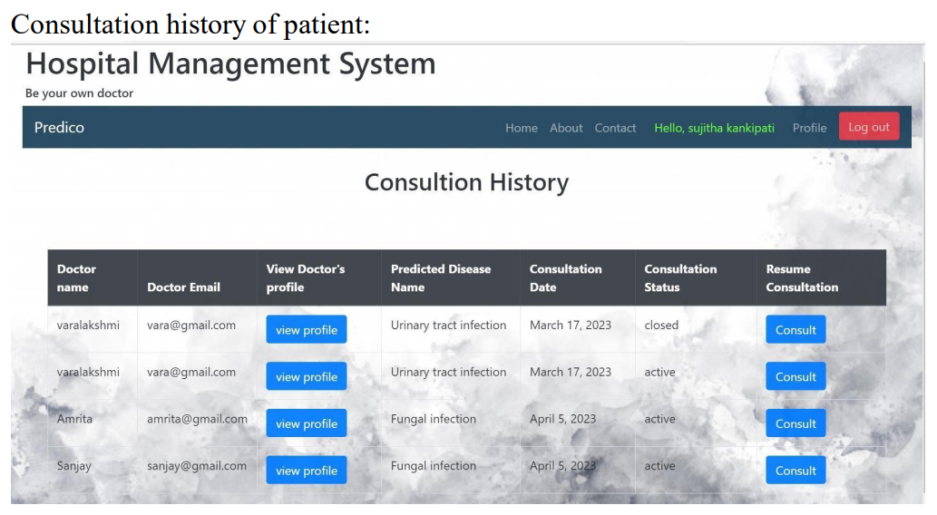

Slide 26
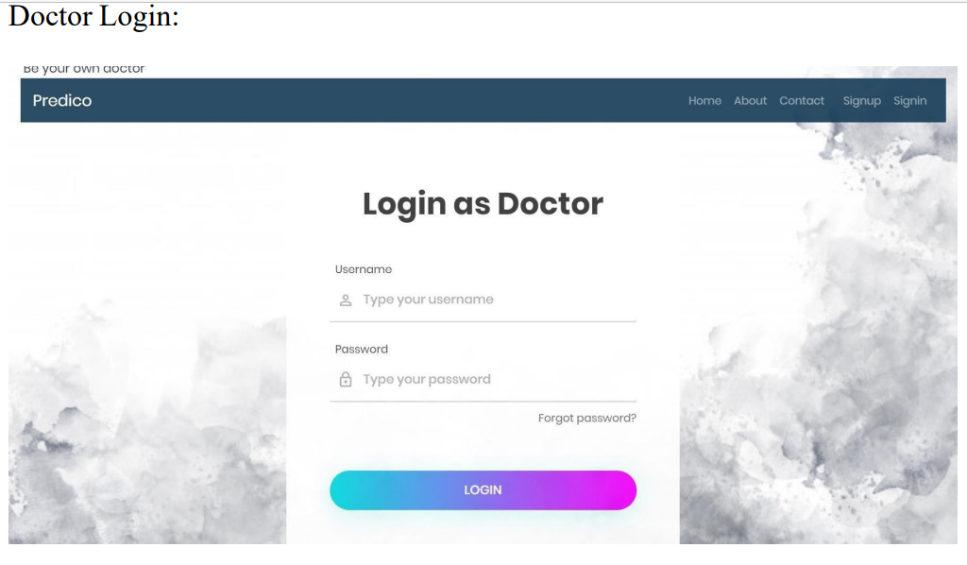

Slide 27
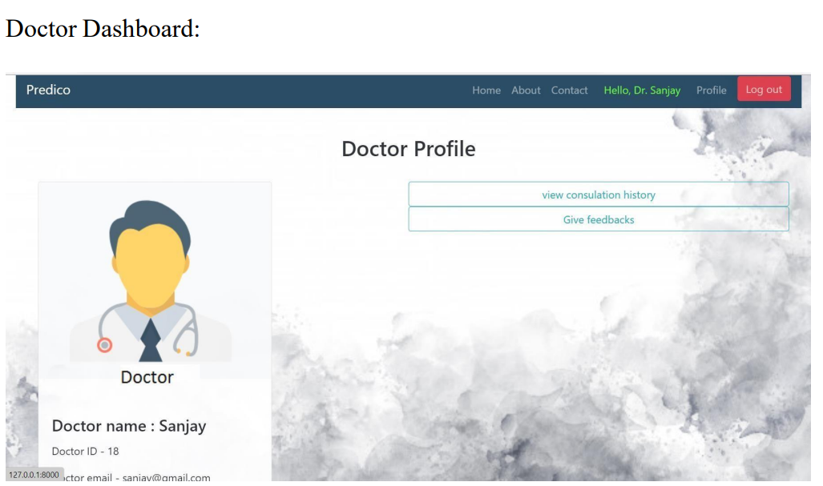

Slide 28
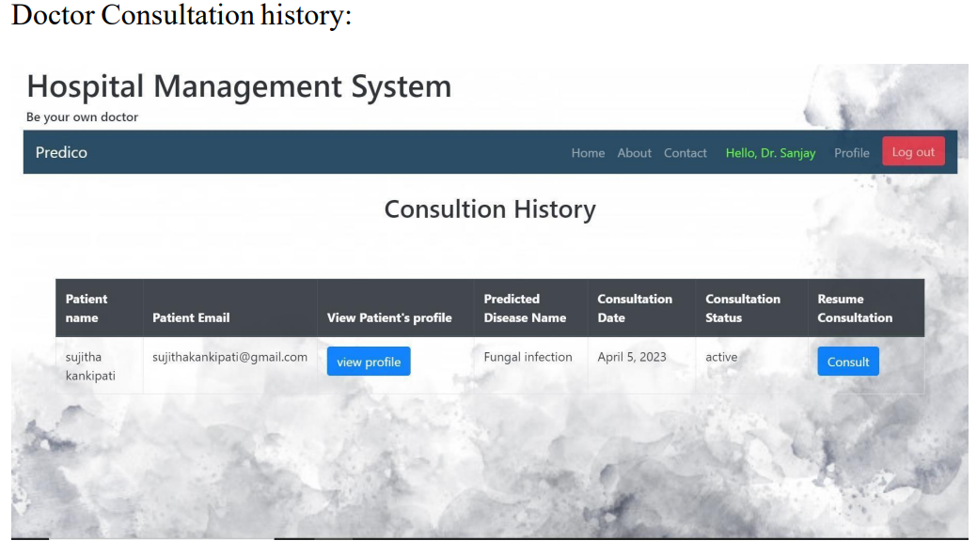

Slide 29
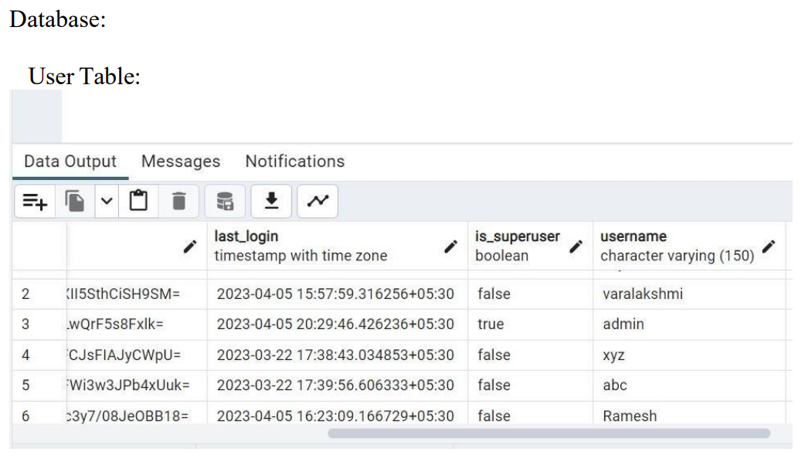

Slide 30
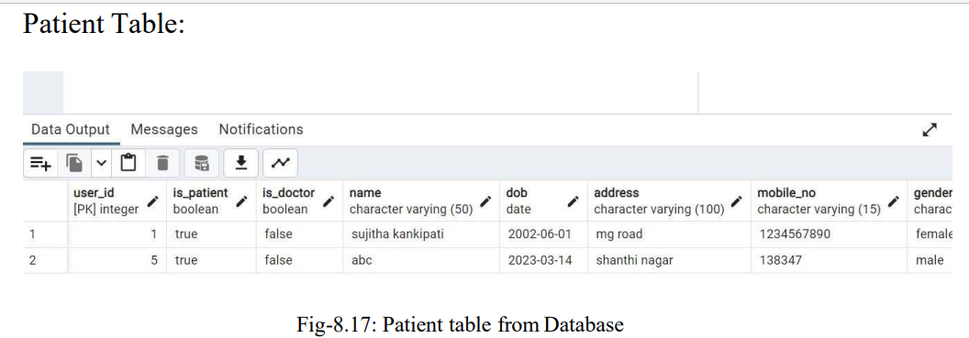

Slide 31
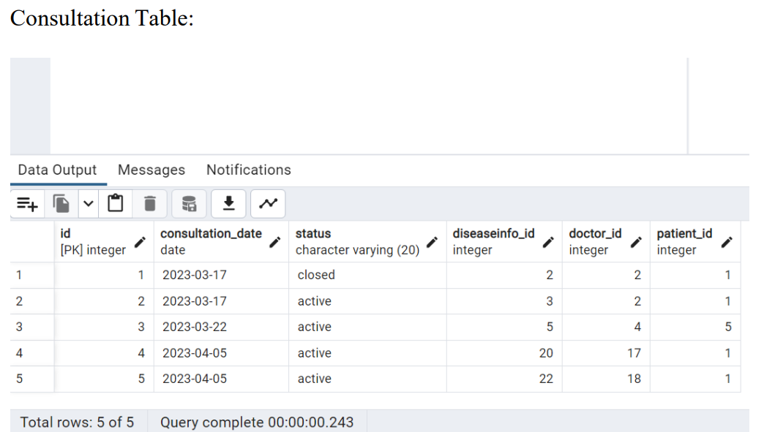

Slide 32
Attainment of objective
From Patient’s login, a user can Book an appointment with any doctor and check appointment history.
Admin can manage doctors, patients, Add Doctor specialization, and check Doctor’s and Patient’s session logs.
This system makes easy management of hospital for the patients as well as doctors.
The system should predict the disease based on the given symptoms
The system should suggest the doctors for predicted diseases
The system should allow the doctors and patients to communicate via chat box

Slide 33
Future scope of Project
We can further improve accuracy by applying the dataset to many different algorithms such that it fits the data completely.
In future, we can develop it as a mobile application such that users can use it very easily and efficiently.
For this project, we can add the video conferencing and telephonic call feature for more effective communication
We can reduce the burden on doctors by saving time and energy.

Slide 34
THANK YOU

